Slide 1
Innovation for AAL

Slide 2




Meet our Team
Luis Alarcon CSCE 22’
Santana Gonzales
ITDE 23’
Juan Perez
ISEN 21’
Mualla Argin
CPSC 23’
Notes:
Hello, we are team #, and our names are: ….

Slide 3

Business Thesis
Our team will identify KPIs that the Army Applications Lab can use to evaluate the success of innovation projects
Notes:
Juan

Slide 4
Number of Customer Interviews
So far we have 17 customer interviews
Most Recently:
COL Jay Whisham, Arthur Trevethan, Adin Pfeuffer, and
Dr. Chung
Notes:
Add number of customer interviews

Slide 5
Key Interviews
COL Jay Whisham
Director of AAL
Liked the rubric idea
Rating and Ranking project success
More insights to AAL
Adin Pfeuffer
Vice President of Programs at Peak Nano
Mentioned existing PM tools such as Smart Sheets
Further reinforced measuring milestones

Slide 6
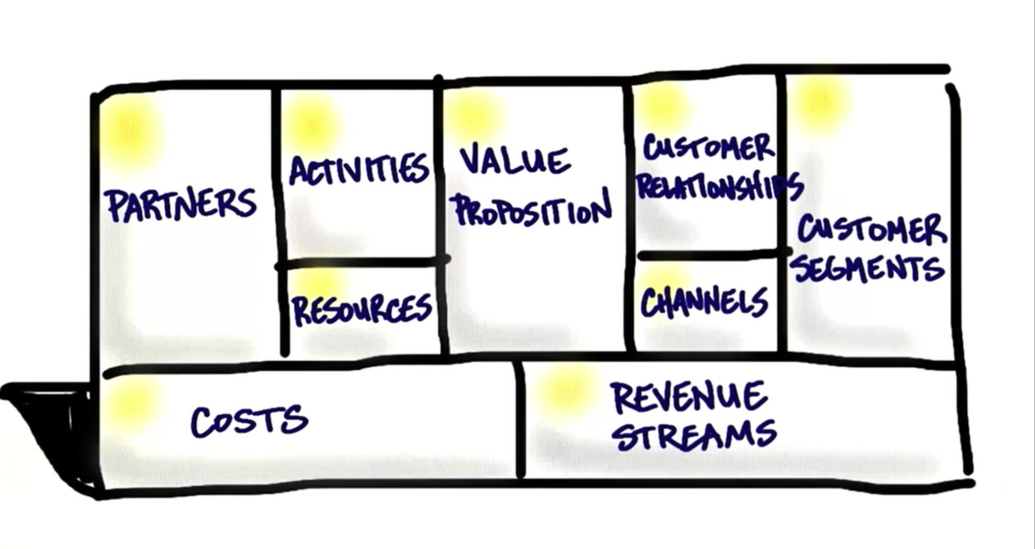
Mission Model Canvas

Slide 7

Value Proposition
We return the power of choice to our customers by measuring the innovative success of their investment mid project.

Slide 8

2. Customer Segments
Primary Example
Army Application Laboratory
Type
Business to Business
Description
Business that are invested in research and development projects that are interested in measuring the innovative success through KPIs

Slide 9
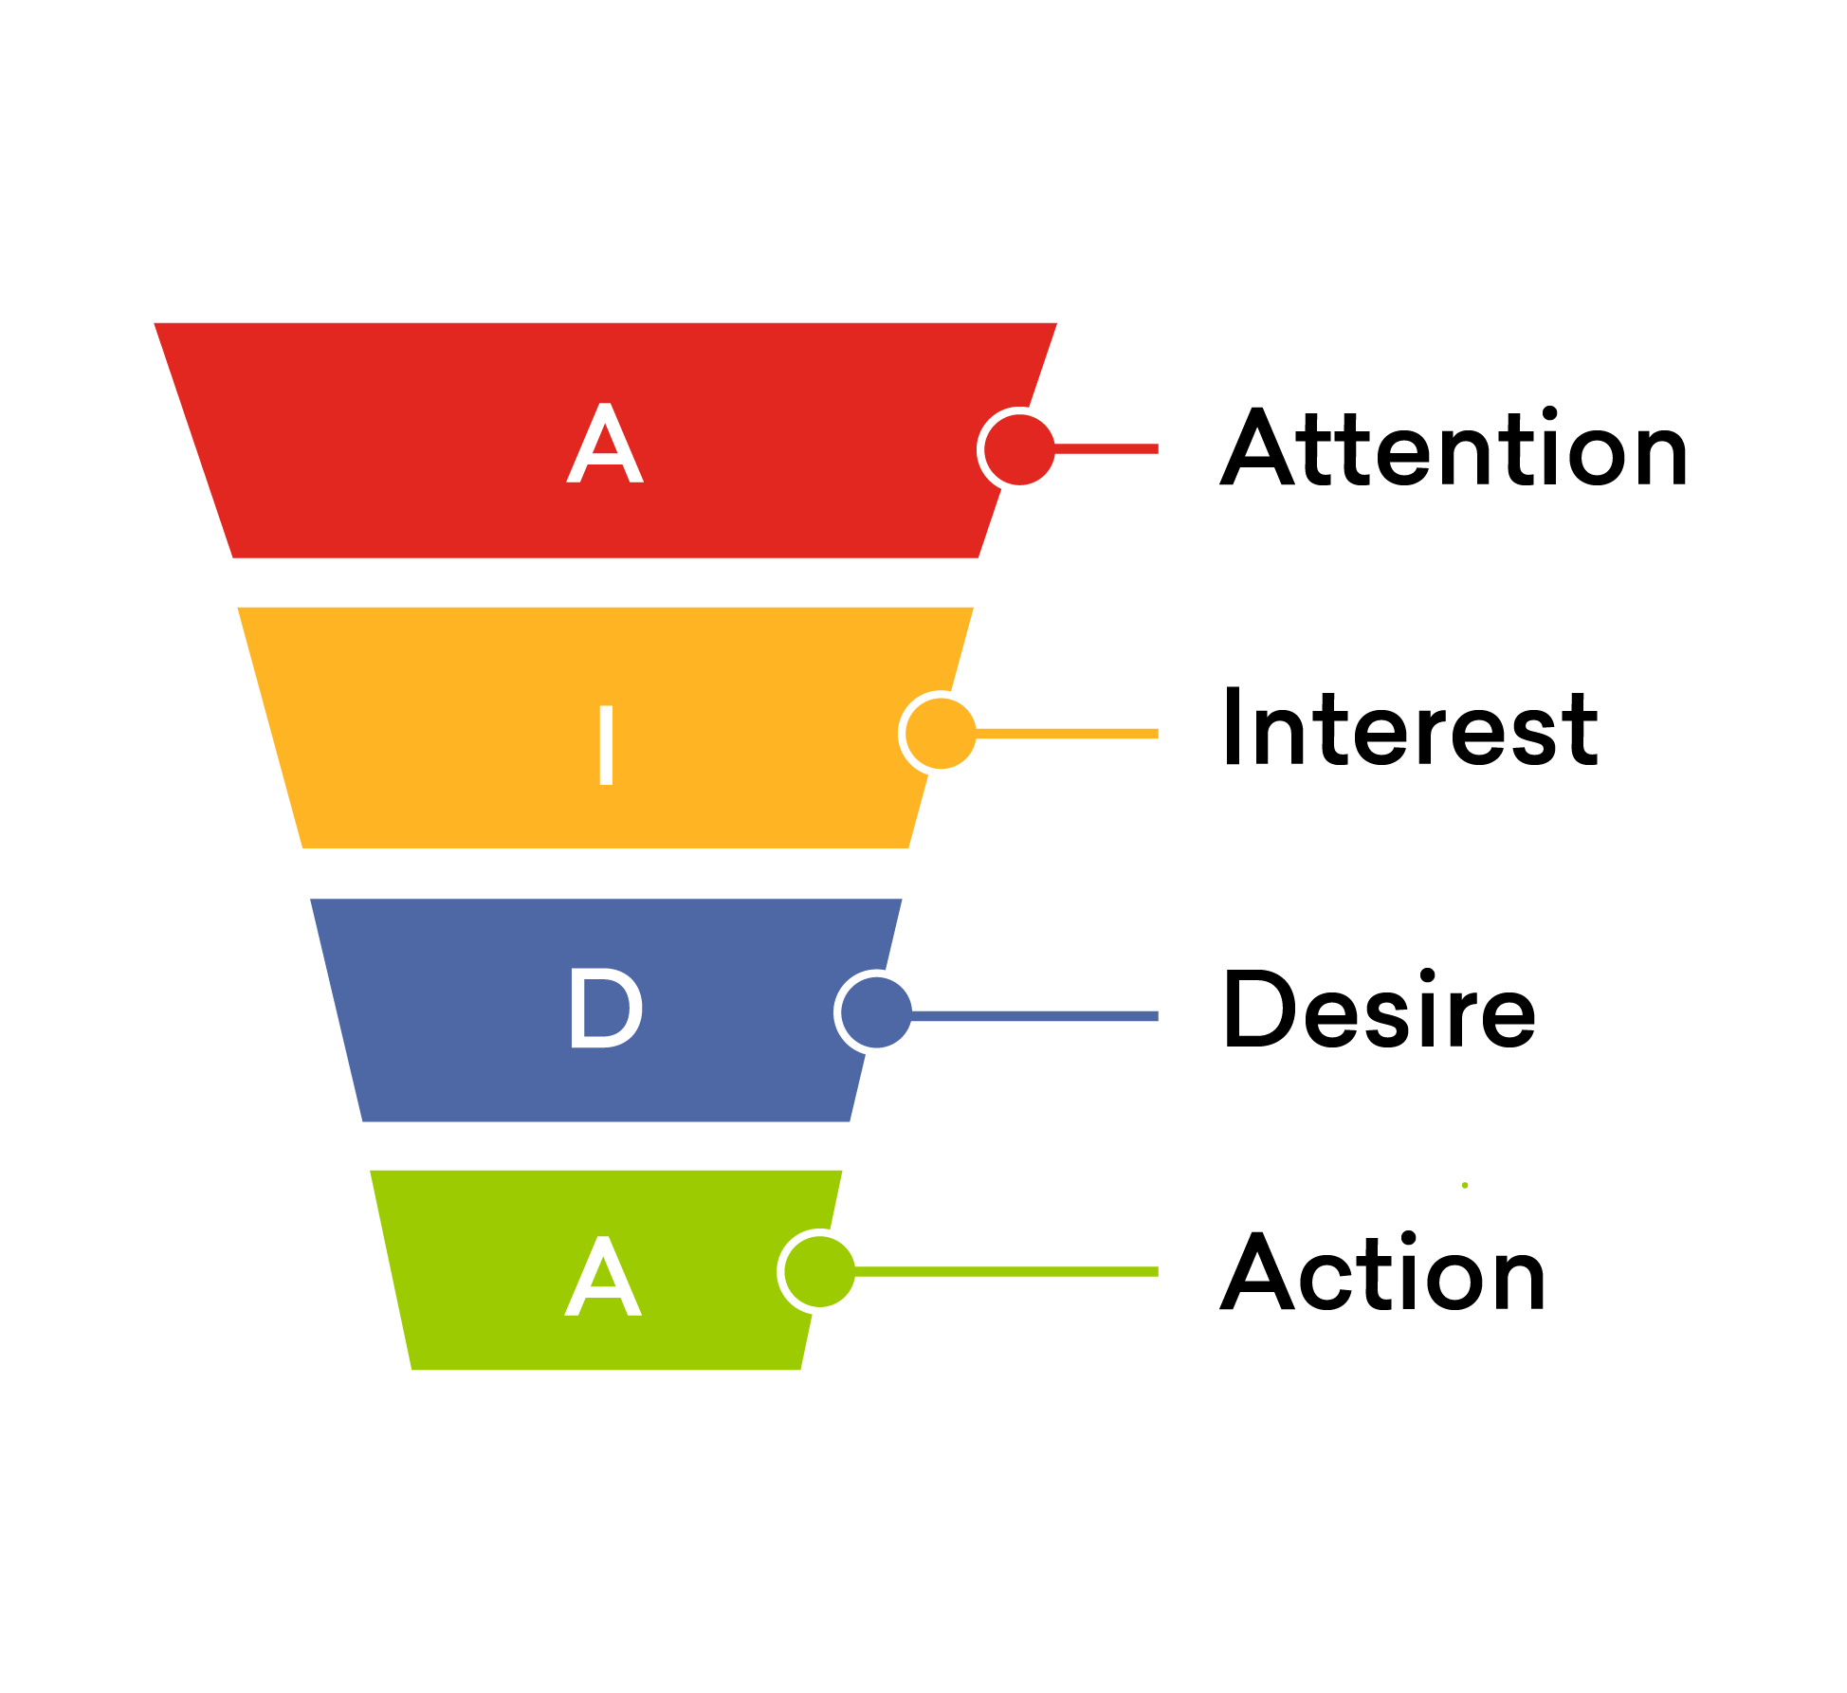
3. Channels
Physical Channels
Word of mouth
Tech Conferences
Online Channels
Email
Website

Slide 10
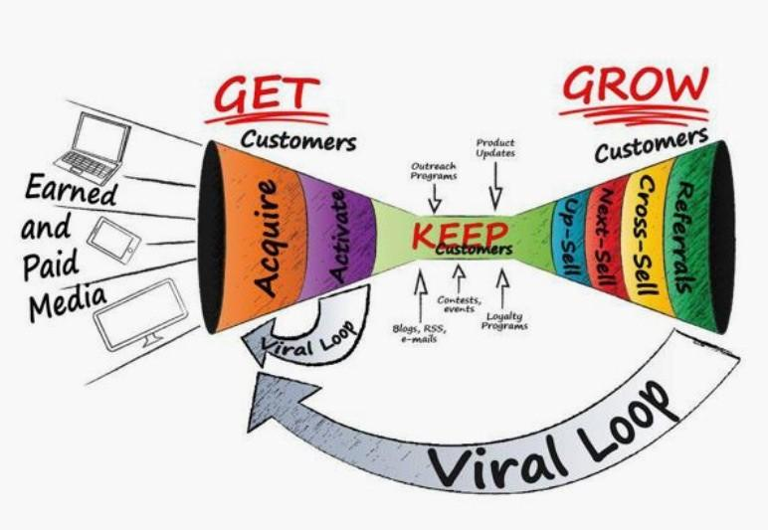
4. Customer Relationship
Get
Week trial
Keep
Constant updates
Grow
Referral programs

Slide 11
5. Revenue Streams
Subscription Based
Monthly
Yearly
Prices based on size of business
More data will require more service
Value
The ability to catch a project to fail is saving millions of dollars

Slide 12

6. Key Resources
Finance
Cloud Storage for Data
Intellectual
AAL dataset and case study
Human
Software Engineers, UI Designers
Notes:
Key Resources
What are the most important assets required to make the business model work?
Finance
Raising Money
Line of Credit
Physical
Manufacturing
Machines
Vehicles
Intellectual
Patents
People
Customer Lists
Human
Software Engineers

Slide 13

7. Key Partners
Army Applications Laboratory
U.S. Army Combined Arms Support Command
Long Range Precision Fires Cross Functional Team
Next Generation Combat Vehicles Cross Functional Team
and more..
Notes:
Key Partners
Who are the key partners and the suppliers needed to make the business model work?
What key resources are we acquiring from them?
What key activities do they perform
CASCOM - U.S. Army combined arms support command (trains army &civilians)
LRPF - Long Range Precision Fires
NETWORK - Ask Perley
NGCV - Next Generation Combat Vehicles
PNT - Positioning, Navigation and Timing. ... Navigation is the ability to determine current and desired position and apply corrections to course, orientation, and speed to attain a desired position anywhere around the world, from surface to surface and from surface to space.

Slide 14
Next Steps:
Future Interviews :
AAL PMs, Consulting Firms, Dr. Biswas, Adam Blandford
Validate the use of Project Management software
Smart sheets
Microsoft Project
Discuss current metrics with Dr.Perley

Slide 15
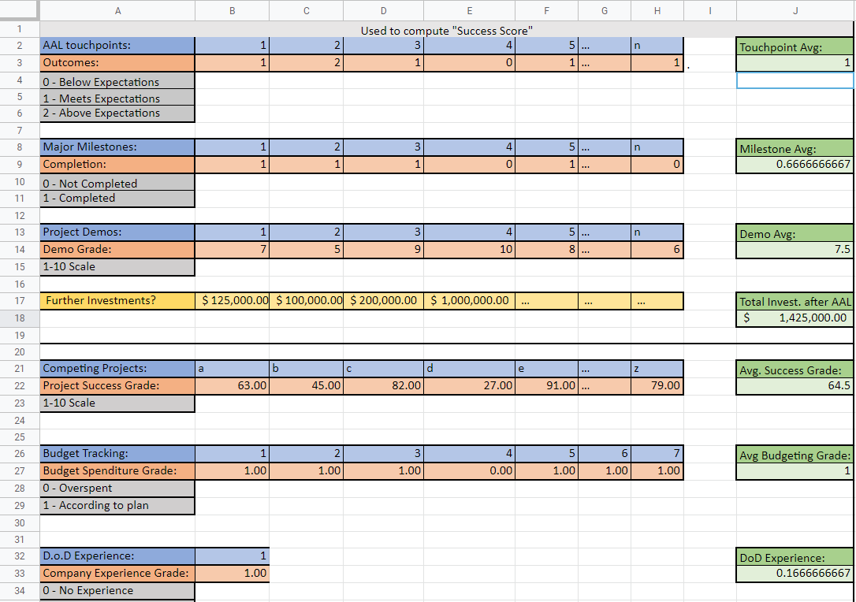

Slide 16
Questions?

Slide 17
References:
https://aal.army/
https://aal.army/what-we-do/
https://aal.army/our-team/
https://www.mckinsey.com/business-functions/strategy-and-corporate-finance/our-insights/how-to-take-the-measure-of-innovation

